Slide 1
Operations Support Specialists (OSS) Information Session May 14th, 2025

Slide 2
Data Strategy & Business Operations Team
Team Structure
Our 90 Days Focus
Power BI Field Dashboard
ICE → KPIs, IDS+ & BEST
Data Engineering
OSS Transition to Syreon
3EM Launch → Replacement of HIP
Eric Simard
Head Data Strategy and Business Operations
Caroline O’Brien
Lead, Data Strategy
Alanna Kouyoumdjian
OSS Manager
Marina Riad
Medical Operations Manager
Carole Daigneault
Meetings & Events Manager
Harini Sanjay Pathak
Data Engineer
Manon Aube
Ops Supp. Specialist
Hilary Danger
Med Ops Coord.
Patrick Bancerz
BI Developer
Linda Mitchell
Ops Supp. Specialist
Oussama Rabehi
Med Ops Coord.
Aniruddha Namjoshi
Project Manager
Frida Martinez
Ops Supp. Specialist
Leandra Ercoli
Med Ops Coord.
Nandani Yadav
Data Analyst
Rania Chahed
Ops Supp. Specialist
Simron Kaur
Med Ops Coord.
Vacant
Data Manager
Stephanie Sultan
Ops Supp. Specialist
Melody Charron
Med Ops Coord.
Syreon
Ashveer Hurnam
Ops Supp. Specialist
Med Mazher
Med Ops Coord.
New Role

Slide 3
OSS Main Responsibilities
PO Management (Creation of Purchase Order (PO) requests including amendments and changes to phasing/delivery dates)
GR Management (Collaboration with brand teams & finance to record the good received (GR) in the right months to ensure P&L accuracy)
Payment Requests (BeSure activities payment i.e. Sponsorship, Membership, Patient/PAG Speakers, Preceptorships, Donations, etc.)
Fuse Management (Content Approval Platform)
Ashfield Warehouse Management (Printed Promo Material for all brands)
P-Card Payments (Purchases to be made on a Novartis P-Card)
HCP External Engagements (HIP platform that processes HCP payments for their collaboration in non-promotional events)
Meeting Planning (Coordination of internal and external meetings logistics)

Slide 5
Operations Support Specialists

Slide 6
OSS Points of Contact
Name | Category | Therapeutic Area
Alanna Kouyoumdjian | OSS Manager Fuse Country Lead/ Ashfield Management | Communications, Portfolio (Pharma)
Frida Martinez | Fuse/Ashfield | Immunology, Medical, Neuroscience, Oncology, RLT
Linda Mitchell | Purchase Orders/P-Card | ERC, Immunology, Neuroscience, Oncology
Manon Aube | Purchase Orders/P-Card | BE&E, Portfolio Management, RLT, P&O
Rania Chahed | Purchase Orders/P-Card | Communications, Finance, Medical, Public Affairs, Value Access, Supply Chain
Stephanie Sultan | Payment Requests | Communications, Oncology, Patients, PAGs, Public Affairs, Value Access
Ashveer Hurnam | Payment Requests | Finance, Immunology, Neuroscience, Portfolio Management, RLT

Slide 7
End to End PO process
Busines Owner reviews estimate
PO request
OSS creates PO
PO approved
Receive invoice
Request GR
Review vendor estimates/proposals.
Ensure cost breakdown matches contract prices.
Clarify discrepancies with suppliers.
OSS team to review back up documents
OSS team to create PO in eShop and upload documentation for approvers review
Once PO is approved OSS team notifies BO and a copy is sent to the supplier
PO is approved through e-shop by different approvers based on MAL/FIKO guidance
Suppliers send invoices via ARIBA or directly to Accounts Payable (AP).
Vendors must not be paid before the services have been rendered or goods have been received.
BO submits PO request through OSS HUB.
BO responsible for the correct supporting documents
The vendor is fully onboarded S360 and ready to be used.
Business Owners must let their OSS business partner know much to GR for each PO prior to the monthly GR deadline to release invoices for payment
Request GR before receive invoice .

Slide 8
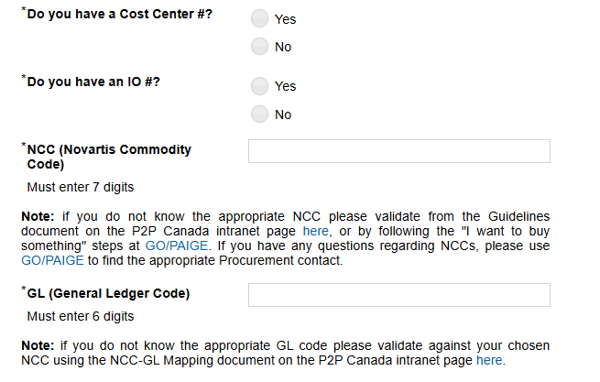
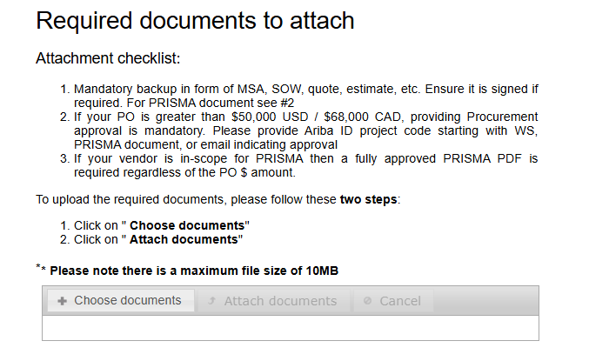
Information Needed For PO Creation
If unsure, contact BPA
If unsure, contact Procurement
If unsure, contact R2R

Slide 9
GR Process & Deadlines
Month | Deadline
May | May 28
June | June 26
July | July 29
August | August 27
September | September 26
October | October 29
November | November 24
Process
Connect with your OSS SPOC around mid-month to align on what needs to be part of the monthly GRs and keep them updated of any fluctuation ahead of the deadline
December Ways of Working
In November, finance will run a year-end training and they will provide all December deadlines

Slide 10
Payment Request: BeSure Business Owner Responsibilities
All business owners (BOs) are responsible for submitting, maintaining and reconciling their BeSure requests.
BOs are required to have their requests approved prior to requesting payment processing.
No payment request should be submitted to OSS until your BeSure (if required) is fully approved.
BOs are responsible to manually request payments when required.
There is NO connection between BeSure and OSS, and we are not advised when your requests are approved. If a payment is required, the BO must submit proactively via the OSS Hub, providing all required information.

Slide 11
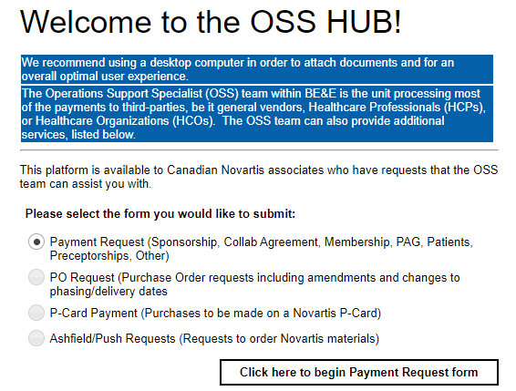
End to End Payment Request Process
Business Owner submits payment request to OSS HUB.
BO responsible for the correct supporting documents
OSS team sends Sponsorship Agreement letter for initials via docu-sign to vendor/organization
Business Owner attaches the payment request to their BeSure as part of the reconciliation step
Supplier inquiries: Ap-followup.ca@novartis.com
(this link can only be used by suppliers).
1
2
3
4
5
6
OSS team verifies request & back up documents.
OSS team completes payment request form and sends to account payables and Business Owner
OSS team enters payment into OSS payment tracker for tracking purposes

Slide 12
Payment Request Turnaround
If a valid vendor is in place payment will be sent to AP in 1-3 business days from OSS request IF contracting has already taken place or is not needed. Once payment has been sent to AP, OSS will update the request status in the OSS Hub.
When a Sponsorship letter or contract is needed, timing will be dependent on how quickly the recipient organization signs the document.
BO is always cc’d on payments & should include the payment document in their BeSure request as part of their reconciliation.
Payment will clear in recipient's bank account per their payment terms.
OSS will check periodically, and once payment has cleared, we will again update the request status in the OSS Hub and advise the BO.
If associates have payment inquiries, you must use our Snow ticketing system.
Here is the link to Snow: Procure-to-Pay Self-Service Portal

Slide 13
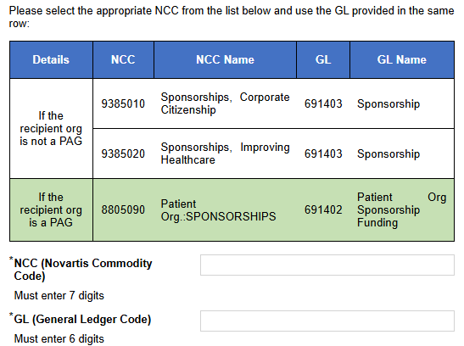
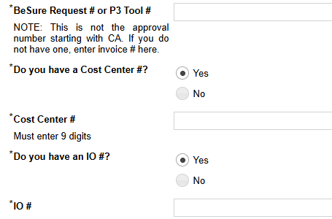
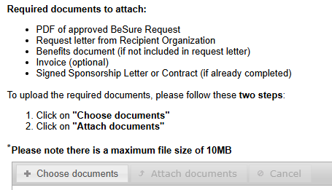
Information needed for Payment Requests

Slide 14
Medical Operations (3EM)

Slide 15
Medical Operations (3EM) Points of Contact
Name | Therapeutic Area
Marina Riad | Medical Operations Manager
Leandra Ercoli | Coordinator for Cross border
Hilary Danger | Coordinator for Oncology and CRM
Oussama Rabehi | Coordinator for Portfolio and RLT
Simron Kaur | Coordinator for IHD
Melody Charron | Coordinator for Neuroscience and Gene Therapy (GTx) and VA
Med Mazher | Sponsorium and "med.engage" vendor accounts monitoring

Slide 16
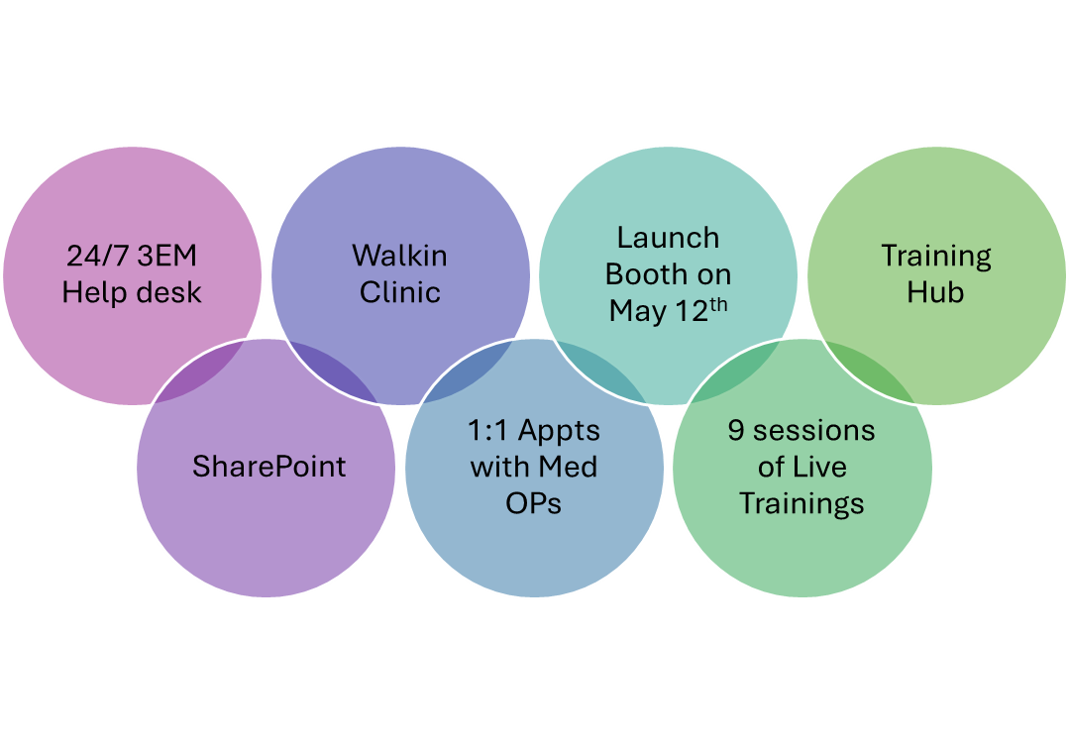
3EM Launch
HIP will continue to be accessible for reconciliation.
Any requests awaiting reconciliation in HIP should be finalized within 30 days after the event concludes.
There are 9 sessions open; if you did not receive an invitation and believe it's relevant to you, please use SharePoint to sign up for the session that suits you best.
Additionally, the walk-in clinic is available for you to register for any session as needed.
Notes:
User Experience is the top of our mind when we are launching

Slide 17
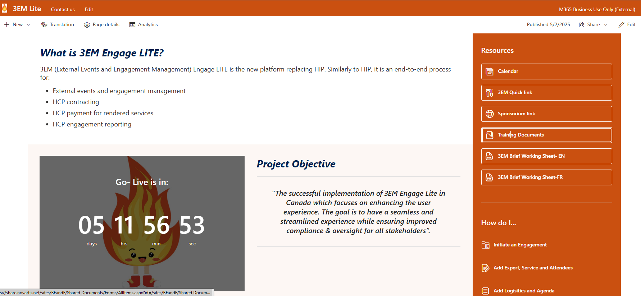
go/canada3EM

Slide 18
Questions

